Slide 1
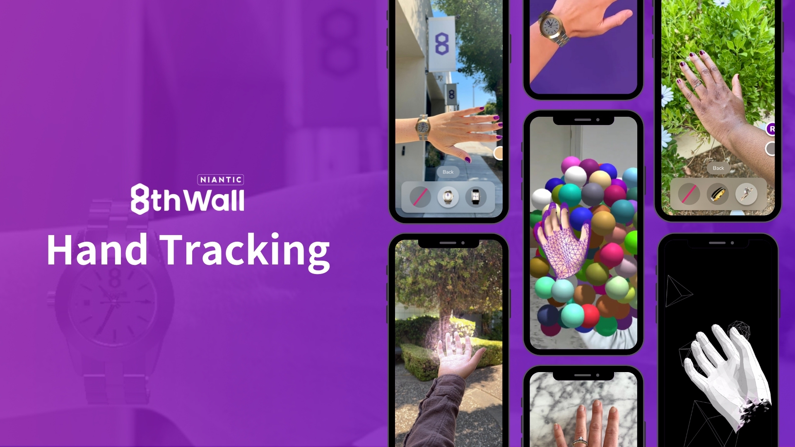

=

Slide 2
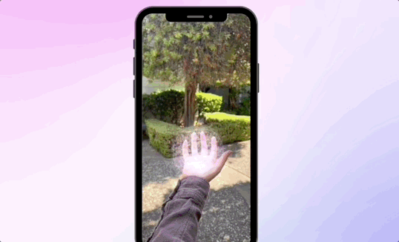
Create hands-on WebAR experiences using hands, wrists, and fingers
Hand Tracking, the latest for 8th Wall’s Human AR suite, equips you with the tools to create engaging experiences that use the entire hand as a canvas for AR.
Innovative Hand Model: Don’t pick just one part of the hand; model extends just past the palm to where a watch sits, unlocking hands, wrists, and fingers in the same experiences.
Ready-to-use attachment points: Get an extra hand in your development with 36 attachment points available out-of-the-box for faster, easier anchoring.
Adaptive hand mesh: Objects are a perfect fit with personalized hand meshes dynamically created for each individual that match objects to the size and volume of their hand.
Handful of new use cases: Create immersive interactions, special effects, virtual try-on and more
Notes:
Need more assets for email or sharing with clients? View the drive here for a collection of GIFs and videos.

Slide 3
Sample | Email Outreach - Option 1
Subject: Enhance your WebAR experience with our new Hand Tracking feature!
Body:
Hi {{first.name}},
Have you heard? 8th Wall just released Hand Tracking, the latest feature for their Human AR suite of tools, giving you the power to use the entire hand as a canvas for AR.
This new tool gives you the ability to construct immersive WebAR experiences that are universally accessible in the browser, enhancing the way your audience interacts with your applications. Whether it's for immersive interactions, puppeteering, special effects, or virtual try-on, Hand Tracking makes it all possible with key features like:
Proprietary hand model that extends just past the palm to wrist
Adaptive hand meshes dynamically created for each individual that matches objects to the size and volume of their hand
36 ready-to-use attachment points out available out of the box
Interested in learning more about how 8th Wall's Hand Tracking can help you unlock a handful of new experiences?Let's schedule a call to discuss further.
Best,
[Your Name]

